Slide 1

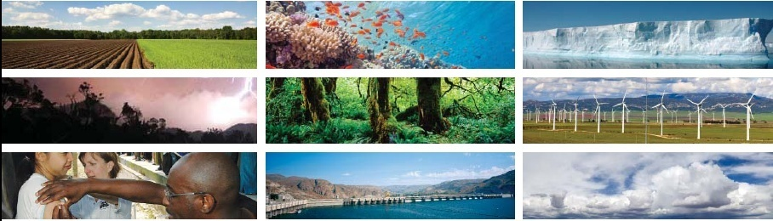
NASA Science Mission Directorate
Earth Science Division
Applied Sciences Program
EcoCast: Improving Ecological and Economic
Sustainability of Fisheries Using Remotely-sensed Oceanographic Data
PI: R. Lewison, San Diego State University
rlewison@mail.sdsu.edu
Notes:
Introduce team
Dr. Elliott Hazen, NOAA, Southwest Fisheries Science Center, Environmental Research Division
Heidi Taylor, NOAA Fisheries, West Coast Regional Office Sustainable Fisheries Division

Slide 2
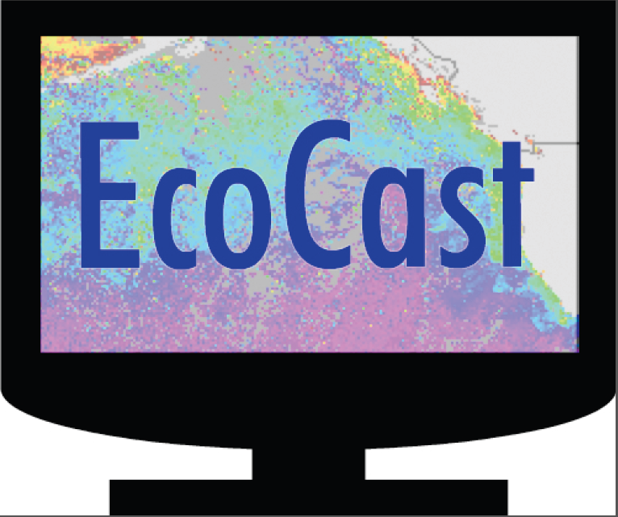
Project title: EcoCast
A flexible, user-driven, and responsive decision support application that uses NASA satellite data to support sustainable fisheries.
Notes:
EcoCast is an integrated model product that can be used to map or evaluate fishing allocations in a dynamic ocean as a function of probable catch and bycatch. EcoCast integrates multi-species distribution models and species-fisheries interaction models, which both respond to dynamic ocean conditions. The integration of those data layers is the EcoCast model output, which can be tailored to meet specific management criteria or thresholds

Slide 3
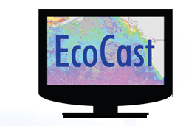
Project team
Project team is collaboration between multiple academic institutions, agencies and NGOs.
Sara Maxwell (Old Dominion), Elliott Hazen (NOAA)
Melissa Stevens, Matt Merrifield (TNC)
Steven Bograd, Scott Benson, Tomo Eguchi,
Heidi Dewar, Suzy Kohin, Tim Sippel
(NOAA Southwest Fisheries Science Center)
Larry Crowder, Dana Briscoe (Stanford Univ)
Helen Bailey (U of Maryland)
Dan Costa (UC Santa Cruz)

Slide 4
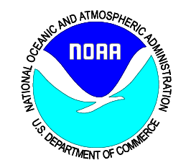
Motivation and context
Ecologically
sustainable
fisheries
Economically
viable
fisheries
Current practices/baseline: fixed & seasonal TACs, quotas, hard caps
Notes:
Our project addresses one of the fundamental challenges of fisheries management in the US (and worldwide) how to balance ecological sustainability with economic viability. This balance is mandated by US legislation but presents a complex mgmt problem that NOAA is required to meet
NOAA has adopted a number of management approaches to support balanced fisheries management (like recurring time area closures or hard caps or take thresholds). Even with these strategies in place, NOAA continues to look for new applications that address the wicked fisheries mgmt problem

Slide 5
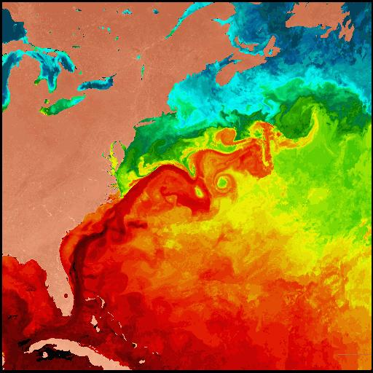
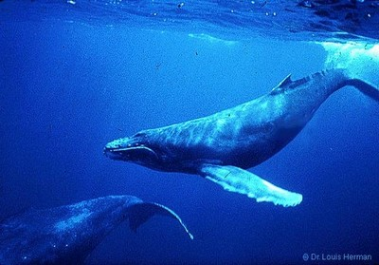
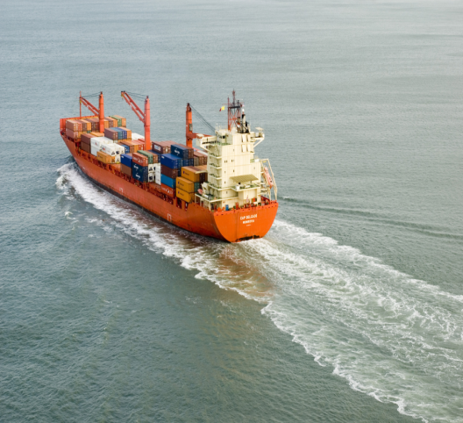
Motivation and context
seascapes
marine life
human uses
are all dynamic

Slide 6
Motivation and context
Static structures are being used to manage dynamic oceans
Marine
protected areas
Time area closure
Management zone

Slide 7
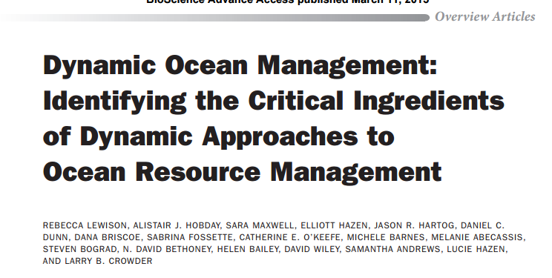
Motivation and context
(Lewison et al. 2015, Bioscience)

Slide 8
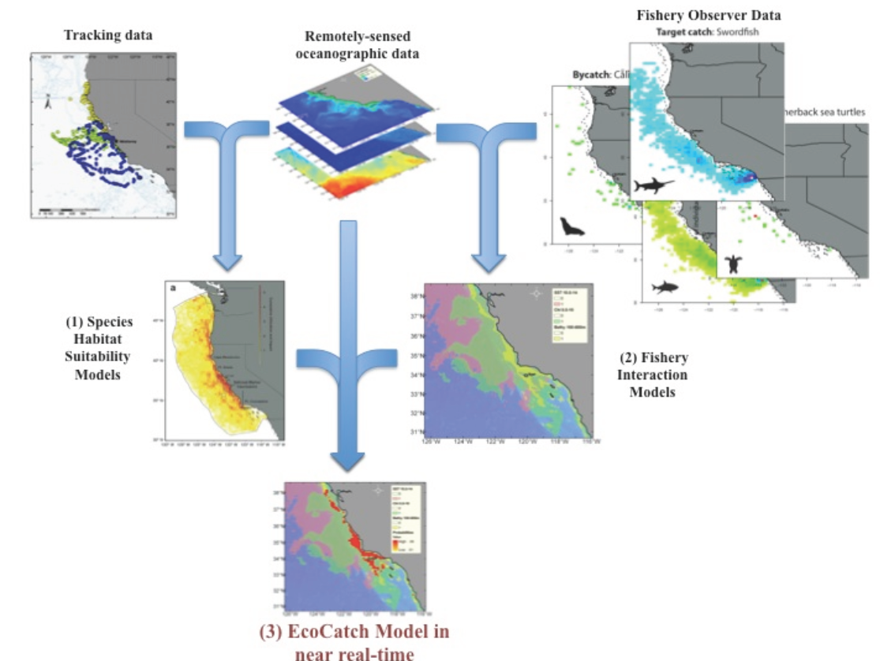
Analytical approach
Leveraging science & technology
EcoCast leverages
Next-gen telemetry (Bailey et al. 2009, Block et al. 2011 )
Innovative spp. distribution modelling (Hobday et al. 2011))
Robust spatial data integration (Pikesley et al 2013)
Notes:
EcoCast is built on a solid foundation of proven data analyses. Our application integrates telemetry data, remotely sensed satellite data and in-situ biological data.
EcoCast leverages best-available science and best-practices that have been proven in data analyses of next-generation telemetry, innovative species distribution modelling and spatial data integration

Slide 9
tele
Satellite

Slide 10
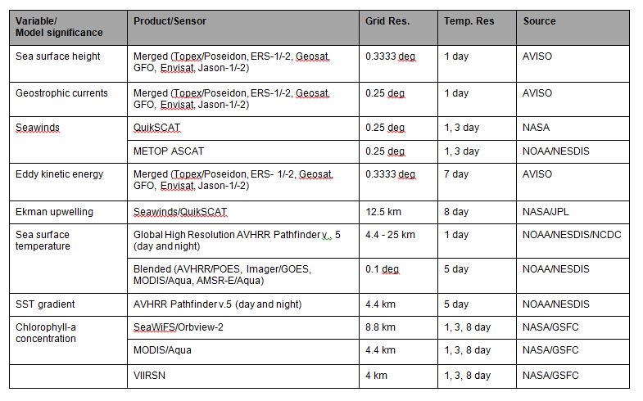
Satellite data/products

Slide 11
Telemetry
tele
Satellite
Fisheries
Species
distribution
models
Fisheries
interaction
models
EcoCast
(integrated model product)

Slide 12
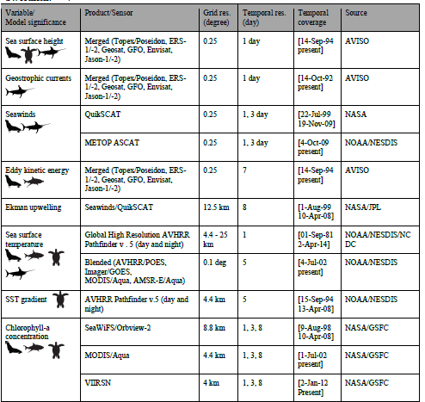
Phase I products
Predictive habitat models have been constructed for each focal species
generalized additive mixed models (GAMMs)
generalized additive models (GAMs)
Model development to continue in Phase II
Notes:
NASA satellite and other satellite derived data are the backbone of EcoCast – we rely on 12 satellite-derived products to capture a range of essential oceanographic conditions that influence marine organism distribution, such as sea surface temperature, sea surface height, chlorophyll, upwelling winds, and mesoscale activity

Slide 13
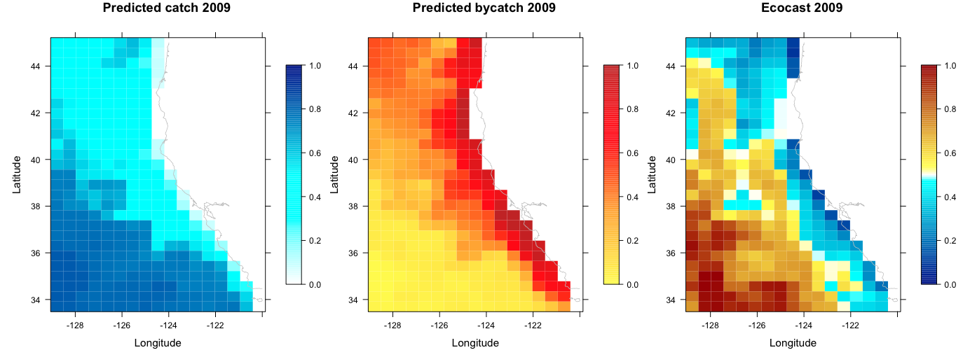
Phase I products
EcoCast Phase I progress demonstrates feasibility, tractability and utility
Notes:
We have made excellent progress in Phase I and our results demonstrate feasibility, tractability and utility of EcoCast

Slide 14
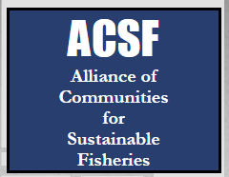
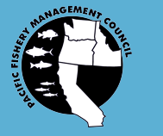
Phase I outcomes
Partner and stakeholder engagement
Working directly with NOAA, industry (Pacific Fisheries Mgmt Council) and individual fishers to ensure EcoCast meets the needs of the stakeholder community
Notes:
From a year of consistent and effective outreach with our partners at NOAA, with the industry council (the interagency, joint powers body that governs the fishery), advisory boards and fishers , we refined the design criteria for EcoCast and built a strong collaborative relationship with partners, end-users, and stakeholders
At these meetings, we have presented our project activities and milestones as well as solicited feedback and input from stakeholders and
end-users.

Slide 15
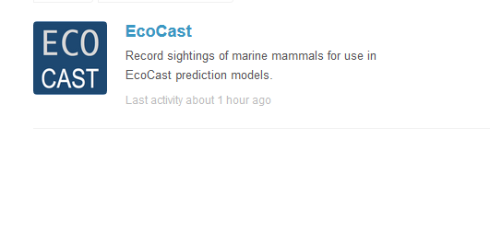
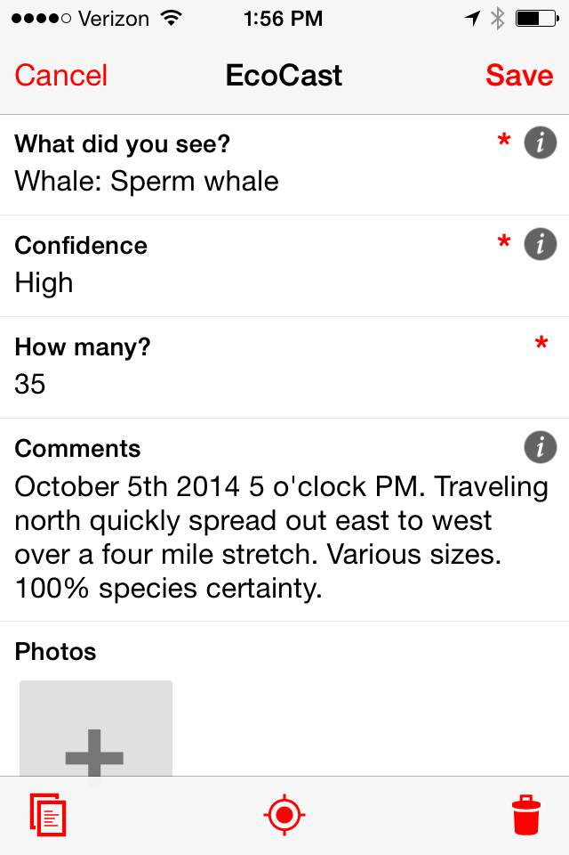
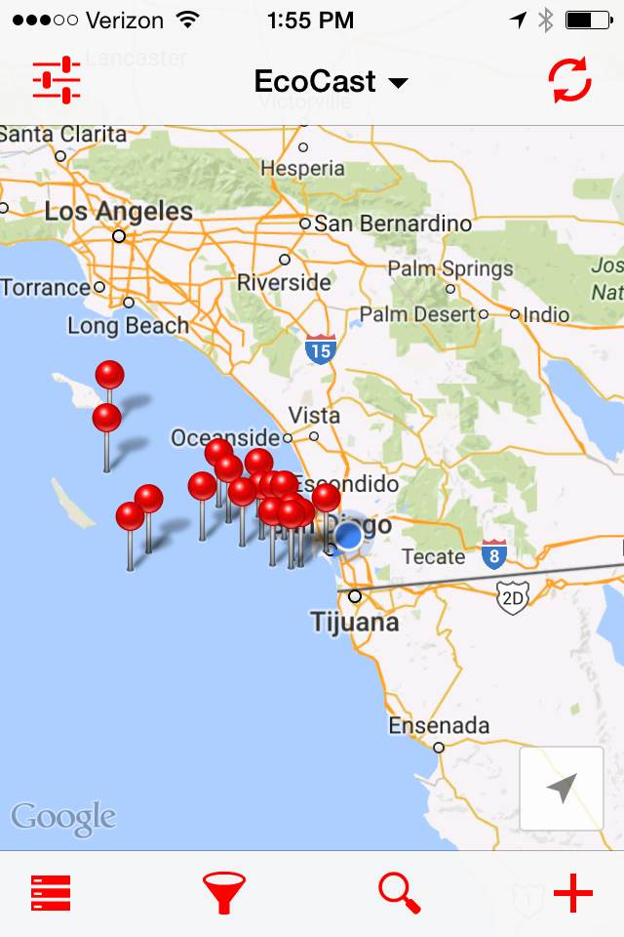
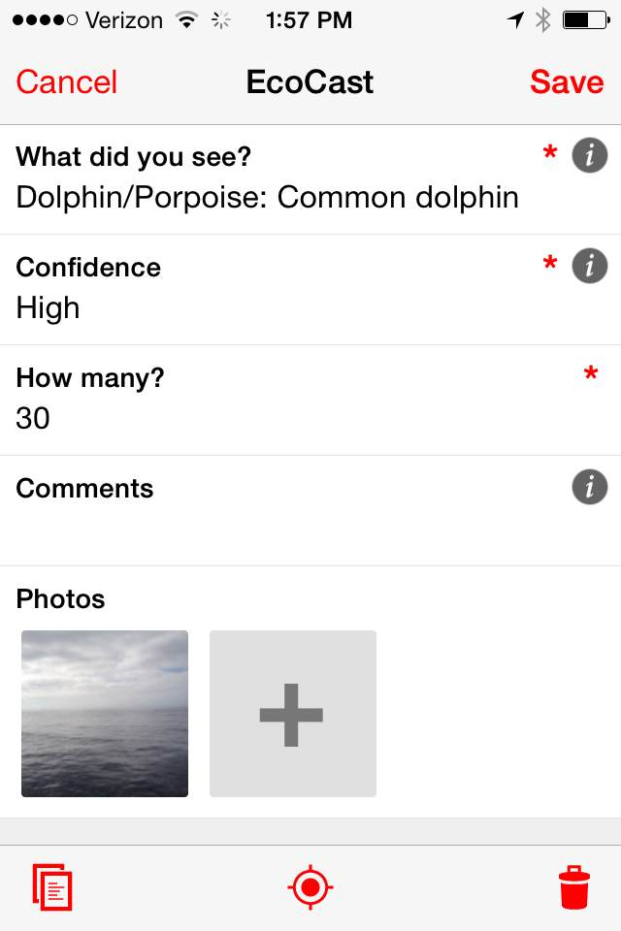
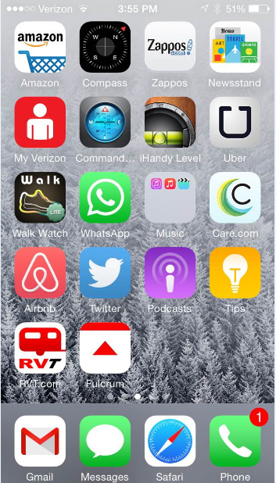
Partner/stakeholder engagement
Tool to collect opportunistic sightings of non-target species
In collaboration with TNC

Slide 16
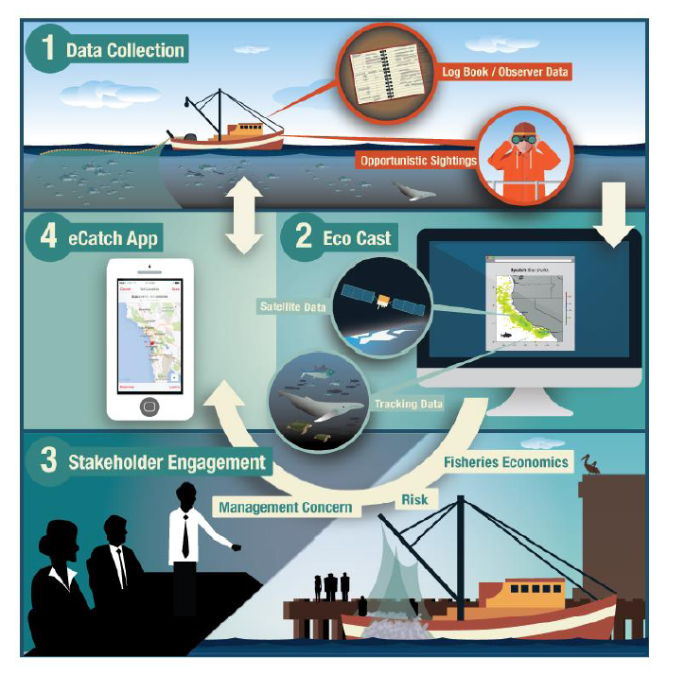
Phase II
Data integration
Ensemble model approach
California Current Regional Ocean Modeling System (ROMS)
temp & spatial resolution
Improve ocean
characterization
EcoCast App
EcoCast
Crowdsource data

Slide 17
Sustainability
Built to be compatible with and be supported by existing NOAA infrastructure
ERDDAP (Environmental Research Division's Data Access Program): tech-supported NOAA server with capacity to store and maintain EcoCast data
Partners, end-users and stakeholders playing key role as participants, expert reviewers and focal user groups
Notes:
To ensure sustainable implementation and mitigate risks, we have designed EcoCast to align with existing and stable supported NOAA infrastructure.
EcoCast models, results, and final products will be housed at ERDDAP (Environmental Research Division's Data Access Program).
ERDDAP is a NOAA data server that provides a simple, consistent way to download subsets of scientific datasets in common file
formats while also producing near-real time graphs and maps.
ERDDAP’s data management and dissemination architecture will facilitate the integration of EcoCast data and dissemination to stakeholders.

Slide 18


Acknowledgements
Notes:
To ensure sustainable implementation and mitigate risks, we have designed EcoCast to align with existing and stable supported NOAA infrastructure.
EcoCast models, results, and final products will be housed at ERDDAP (Environmental Research Division's Data Access Program).
ERDDAP is a NOAA data server that provides a simple, consistent way to download subsets of scientific datasets in common file
formats while also producing near-real time graphs and maps.
ERDDAP’s data management and dissemination architecture will facilitate the integration of EcoCast data and dissemination to stakeholders.

Slide 19
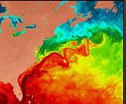
Motivation and context
Wicked problem of balancing multiple objectives and trade-offs
Ocean seascapes, organisms and users are dynamic
Static structures are being used to manage dynamic oceans
disconnect

Slide 20
How do we define DOM?
HOW
“ management that changes in space and time in response to the shifting nature of the ocean and its users based on the integration of real-time or near real-time biological, oceanographic, social, economic and other data.”
(Maxwell et al 2012, Hobday et al 2014, Lewison et al. 2015)

